Slide 1

Modelling Earthquake Damage
Eugene Tan , Huang Shaohang , Nickson Ng , Ong Jinqyee
Notes:
Hi everyone, we are from group 3, and our members consist of eugene , nickson. , jinqyee , and myself, shaohang . Today, the topic we are presenting on is ‘Modelling Earthquake Damage’.

Slide 2




TABLE OF CONTENTS
01
02
PROBLEM STATEMENT
DATA ANALYSIS & OBSERVATIONS
03
04
DATA PREPARATION
PROJECT OUTCOME
Predict level of damage to buildings caused by earthquake
Data visualization & insights
Data cleaning & preprocessing
Mapping predicted level of damage to buildings onto test data
Notes:
First, we will be sharing with all of you on our problem statement. Second, a brief data visualization & observations on the dataset we have worked on. Third, how we cleaned and prepared our data for the visualization and insights. And last but not least, whether our project outcome has been successful in achieving our goal.

Slide 3
PROBLEM STATEMENT
Our objective is to successfully predict the level of damage grade to buildings caused by the 2015 Gorkha earthquake in Nepal with the highest possible accuracy.
Notes:
Our objective is to successfully predict the level of damage grade to buildings caused by the 2015 Gorkha earthquake in Nepal with the highest possible accuracy.

Slide 4

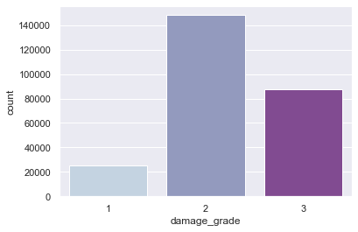
EXPLORATORY DATA
Notes:
First, we used a count plot to determine the general spread of damage_grade across all buildings with the given training data. As seen from the graph, the data we have is highly imbalanced with most of the values falling in the range of damage_grade 2. This is likely due to the damage grade of the buildings being strongly-related to the damage intensity of the earthquake, hence most of the damage grades fall into grade 2.

Slide 5
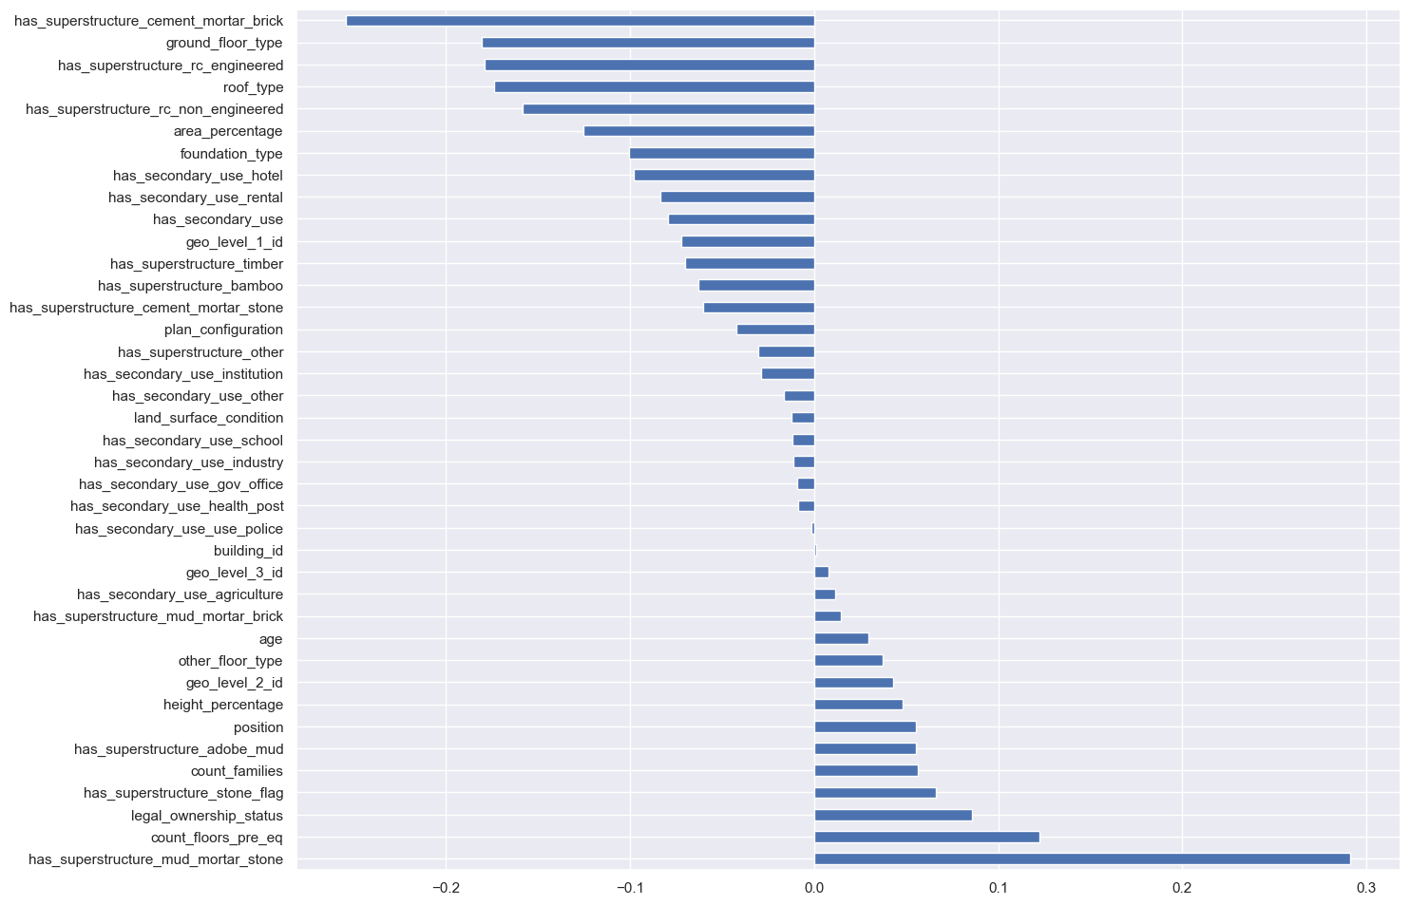
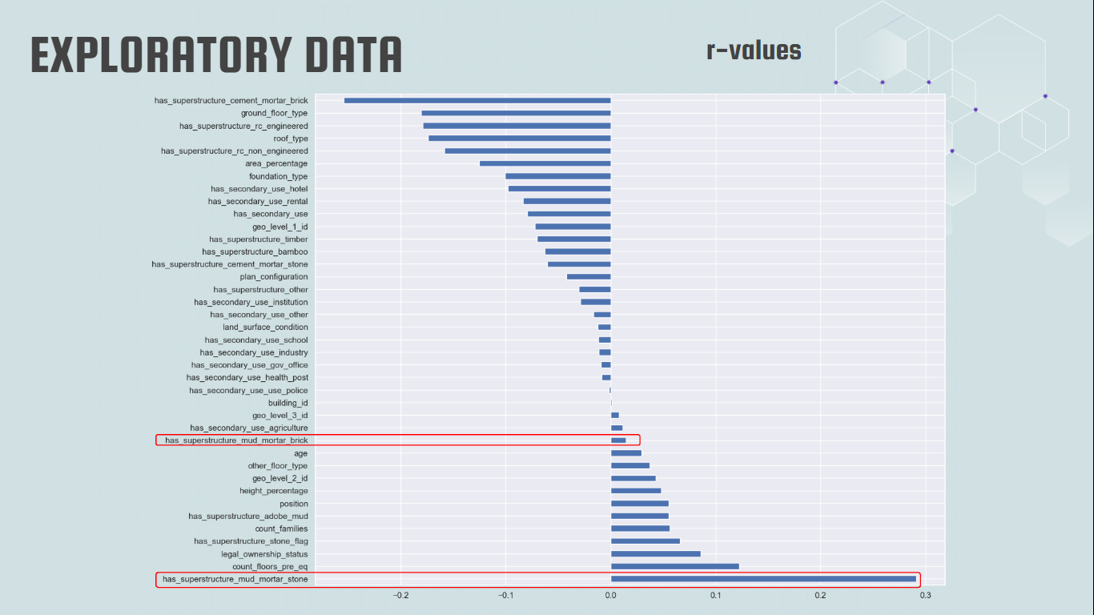
EXPLORATORY DATA
r-values
Notes:
-------Pandas dataframe.corr() is used to find the pairwise correlation of all columns in a dataframe.
https://levelup.gitconnected.com/pearson-coefficient-of-correlation-using-pandas-ca68ce678c04
Over here, we plotted a correlation chart ,using pandas dataframe.corr() function, that shows the correlation value of each variable with respect to the level of damage grade. As we can see, if the absolute value of the number is closer to 1, it means that there is a higher correlation between the column and damage grade. We have picked out 2 variables with one of the strongest and weakest correlations to the level of damage grade for analysis.
These 2 variables are namely: has_superstructure_mud_mortar_stone, has_superstructure_mud_mortar_brick 32 secs

Slide 6
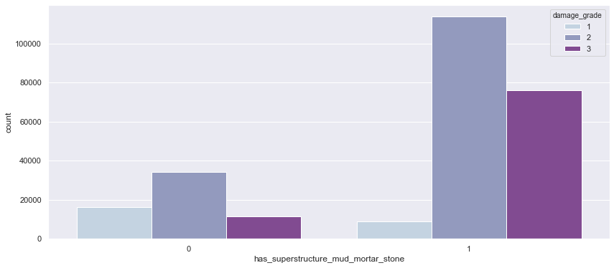
MUD_MORTAR_STONE
|r| = 0.29
Find the codes to draw the line
Density Line
Notes:
We will first start off with mud_mortarstone, the variable with the highest correlation index to level of damage grade. By looking at this graph, what we can infer is the spread of level of damage grade across mud_mortar_stone. In the next slide, we will be teaching you how to infer the correlation between the variable and damage grade.

Slide 7
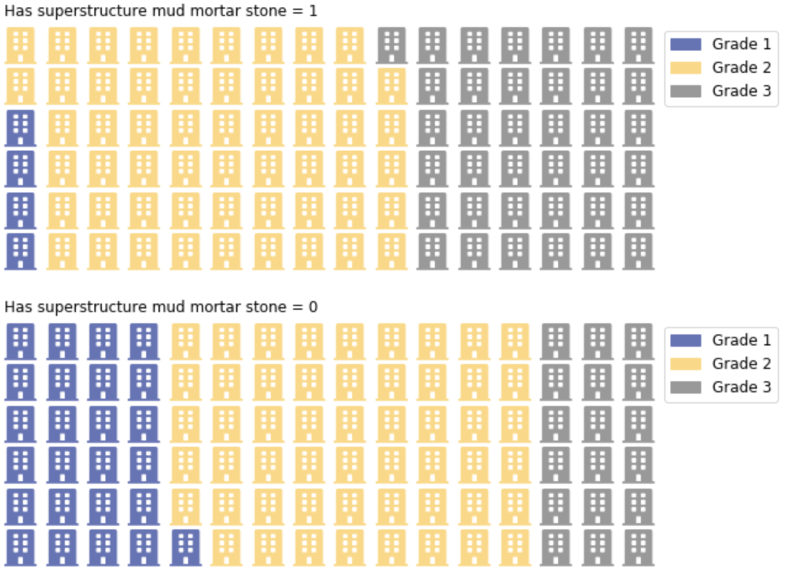
MUD_MORTAR_STONE
|r| = 0.29
Mud_mortar_brick = 1
Size Arrangement
Damage_Grade
1 < 3 < 2
Mud_mortar_brick = 0
Size Arrangement
Damage_Grade
3 < 1 < 2
Notes:
In particular for index 1, the percentage of damage grade 3 is distinctly higher than damage grade 1, whereas for index 0, the percentage of damage grade 1 is higher than 3 as you can see from the chart. Over here, we can conclude that the greater the difference in spreads across the damage grade, the higher the correlation between the categorical variable and the level of damage grade.

Slide 8
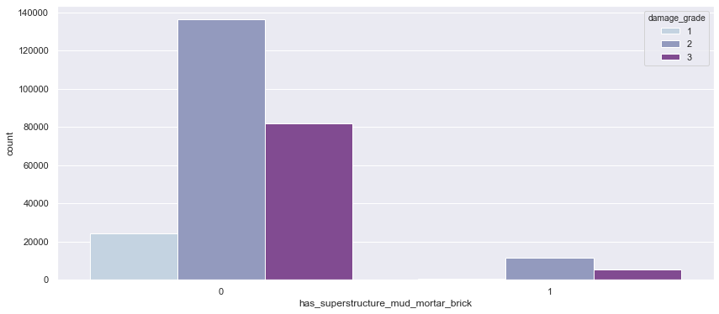
MUD_MORTAR_BRICK
|r| = 0.015
Notes:
Next, we will be using mud_mortar_brick as an example with a low correlation index of absolute value 0.015. As you can see from the diagram, the general outline of the distributions of damage grade takes up around the same shape.

Slide 9
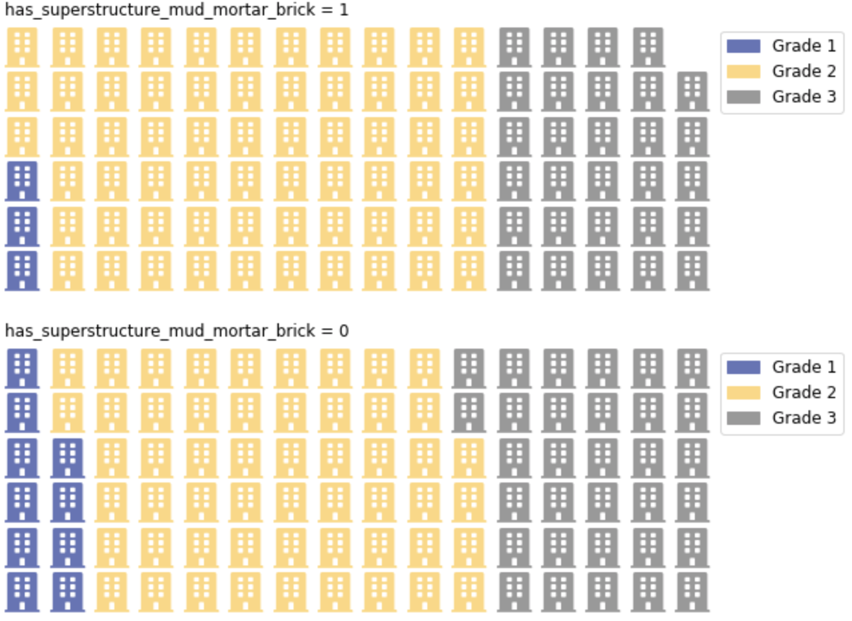
MUD_MORTAR_BRICK
|r| = 0.015
Mud_mortar_brick = 1
Size Arrangement
Damage_Grade
1 < 3 < 2
Mud_mortar_brick = 0
Size Arrangement
Damage_Grade
1 < 3 < 2
Notes:
Unlike the previous variable mud_mortar_stone, the distribution of grade 1, 2, and 3 across index 0 and 1 are fairly even, a simpler way to interpret it will be the order of the percentage, generally if both index 0 and 1 follows the same order, for example damage grade 1 < 3 < 2, it is likely to have a lower correlation to damage_grade.
Next, I will handover my time to Jinqyee who will be elaborating more on the machine learning techniques we have used.

Slide 10
SUPERVISED LEARNING
Classification
Regression
Notes:
There are 2 types of supervised learning techniques. For this project, we are using classification technique as we are classifying the level of damage grades into 1, 2, and 3. First, we categorize the given set of data into classes, then we use the given training data to train a classification predictive model to approximate the mapping function from input variables to discrete output variables. Our eventual goal is to adapt a model that is trained as accurately as possible.

Slide 11
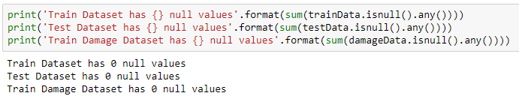
DATASET PREPARATION
Notes:
We checked our data set for any null values, and we found out that the dataset given to us has no NULL values.

Slide 12
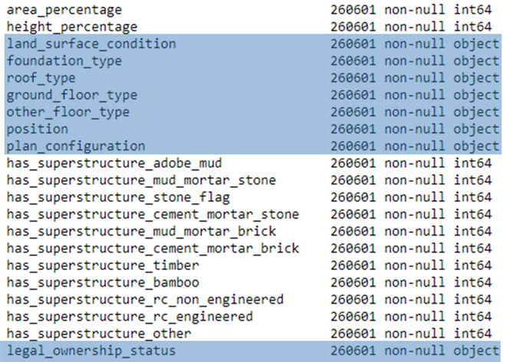
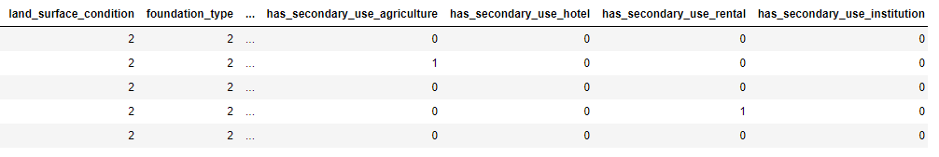
DATASET PREPARATION (Cont.)
However, there were many categorical variables in the dataset. In order to deal with the categorical variables, we made use of encoder to encode the categorical variables into integer values
Notes:
However, there were many categorical variables present in the dataset. In order to perform Machine Learning based on these categorical data, we will need to convert the data into numeric form before applying learning algorithm on them. Hence, we made use of an encoder to encode the categorical data.

Slide 13
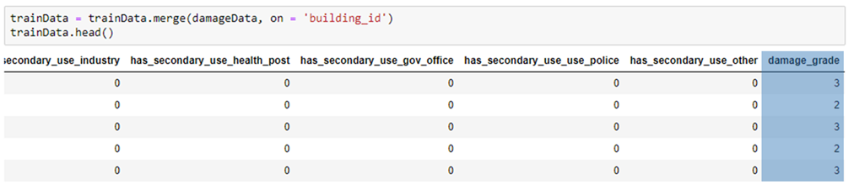
DATASET PREPARATION (Cont.)
Last but not least, we had to concatenate the values of damage grade for the train data that was given in a separate excel sheet
The values of damage grade were mapped according to unique building ID identifiers generated for each building
Notes:
Last but not least, we had to concatenate the values of damage grade for the train data that was given in a separate excel sheet
The values of damage grade were mapped according to unique building ID identifiers generated for each building
Next, i will handover my time to eugene to elaborate on the machine learning techniques we used

Slide 14

MACHINE LEARNING
TECHNIQUES
DECISION TREE
RANDOM FOREST
CAT BOOST
Import DecisionTreeClassifier from sklearn.tree
Works as a simple representation for classifying examples. It is a supervised Machine Learning where the data is continuously split according to a certain parameter
Import RandomForestClassifier from sklearn.ensemble
It works as a supervised learning algorithm that helps to build multiple decision trees to derive a more accurate and stable prediction
Import CatBoostClassifier from catboost
It combines decision trees but they start the combination process at the beginning instead of the end
It is a high performance open source library for gradient boosting on decision trees
Notes:
A decision tree is a simple, decision making-diagram. It is a supervised Machine Learning where the data is continuously split according to a certain parameter.
Random forests works as a supervised learning algorithm that helps to build multiple decision trees independently to derive a more accurate and stable prediction
Cat Boost combines decision trees but they start the combination process at the beginning instead of the end
It is a high performance open source library for gradient boosting on decision trees
(https://medium.com/@hanishsidhu/whats-so-special-about-catboost-335d64d754ae)

Slide 15

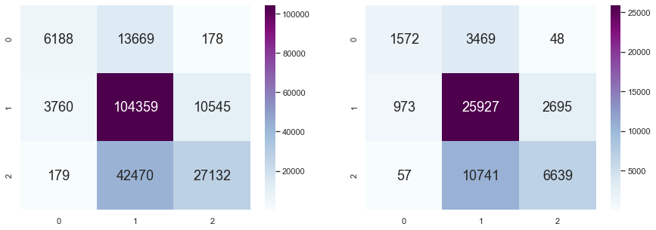
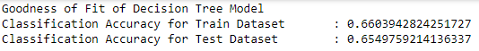
DECISION TREE CLASSIFIER
Notes:
Using the Train data with predefined damage grade, we will split the dataset randomly into 2 sets, 80% is train and 20% is test.
Then, we will fit all predictors excluding building id into the decision tree with a max_depth of 6 and these are the results we obtained.

Slide 16
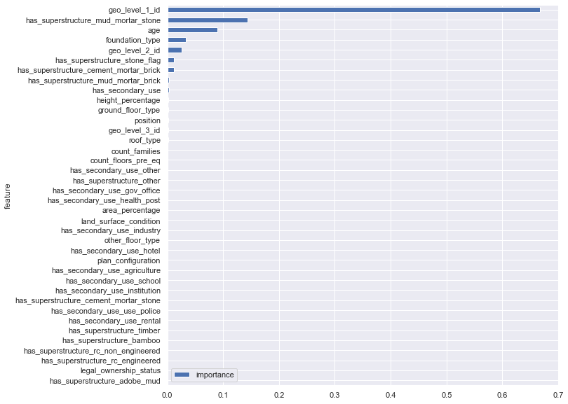
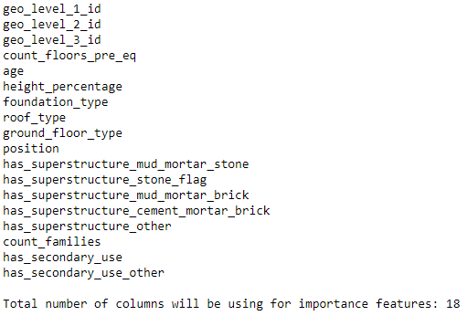
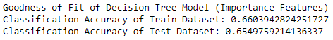
DECISION TREE CLASSIFIER (IMPORTANCE FEATURES)
Importance features that have more than 0.0001
Notes:
While looking at the documentation , we found out that there is a way to check the best gini index automatically by using features importance function (dectree.feature_importances_ function)
On the left, we have a chart showing the importance of a feature of the decision tree gini index. Based on this, we extracted predictors with gini index more than 0.0001 to refit into the decision tree.

Slide 17
BENEFITS OF IMPORTANCE FEATURES
DECISION TREE MODEL
 | Train Dataset of Classification Accuracy | Test Dataset of Classification Accuracy | Columns Used | Memory Usage (byte)
Decision Tree | 0.6604 | 0.6550 | 38 | 53,370,880
Decision Tree (Importance Features) | 0.6604 | 0.6550 | 21 | 26,476,960
Differences | 0 | 0 | 17 | 26,893,920
Notes:
By comparing the decision tree with and without importance features, we can see that the classification accuracy for both train and test dataset is the same. However, lesser columns were used for the importance features and hence, this helped us to significantly reduce the memory usage.
Now i will hand over the time to Nickson to elaborate on other models.

Slide 18

RANDOM FOREST CLASSIFIER (PROS & CONS)
Advantages
Random forest does not overfit
They provide a reliable feature importance estimate
Classification & Regression
Disadvantages
Complexity - Random Forest creates a lot of trees and combines their outputs
Longer Training Period
Notes:
Thanks eugene,now I will be talking about the pros and cons of the random forest classification.
As the number of trees increases due to overfitting, The performance of Random Forests does not decrease
Secondly, It can generate the importance feature base on its gini index
Lastly, Random Forest can be used to solve both classification as well as regression problems.
But there are cons for random forest too, like:
This algorithm requires much more computational power and resources because of its complexity and
Longer Training Period because of the multiple tree generation.

Slide 19
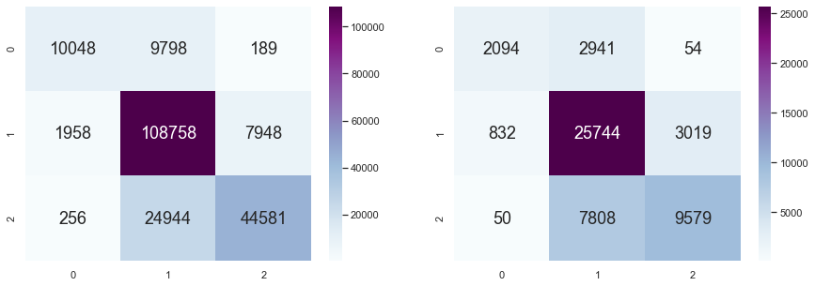
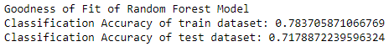
RANDOM FOREST CLASSIFIER (CONT.)
Notes:
How we use random forest is that
we use the same train and test dataset, that we use in the decision tree classifier, to fit it into the random forest classifier. And this is the accuracy that we got.
----------------------------------- not saying -----------------------------
Parameters
n_estimators = represents the number of the trees in the forest
n_jobs = -1 is to use up all the CPUs to run faster
min_samples_leaf: The minimum number of samples required to be at a leaf node

Slide 20
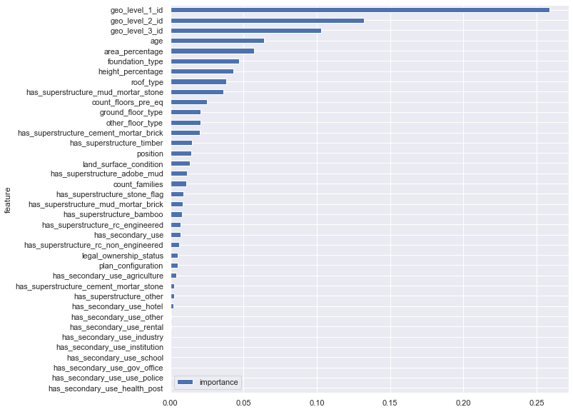
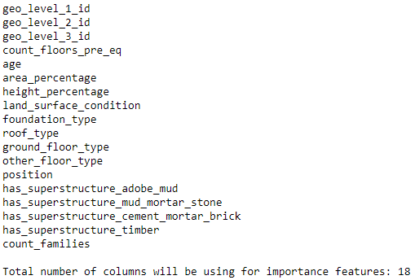
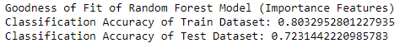
RANDOM FOREST CLASSIFIER (IMPORTANCE FEATURES)
Importance features that have more than 0.01
Notes:
After that we try to improve the accuracy
By using (randomforest dot feature importances) function to get the list of important feature as seen on the left. Base on its gini index, we choose to use a index of 0.01 and above for the stronger predictors, Which is the list on the right.

Slide 21
BENEFITS OF IMPORTANCE FEATURES
RANDOM FOREST MODEL
 | Train Dataset of Classification Accuracy | Test Dataset of Classification Accuracy | Columns Used | Memory Usage (byte)
Random forest | 0.7837 | 0.7179 | 38 | 53,370,880
Random forest (Importance Features) | 0.8033 | 0.7231 | 18 | 22,932,800
Differences | 0.0196 | 0.0052 | 20 | 30,438,080
Notes:
As you can see that there is a increase of 0.01 accuracy after the use of importance features . The memory usage has decrease as well because of the reduced columns

Slide 22

CATBOOST CLASSIFIER (PROS & CONS)
Advantages
Work well with small dataset
Handles categorical data without conversion
Fastest gradient boosting classifier
Disadvantages
Sensitive to outliers
Boosting is more susceptible to overfitting
Notes:
So the other machine learning algorithm that we tried is call,Catboost. and
it can learn well with small dataset and return back very good results
Secondly, It can also convert category predictors into numeric data automatically.
And lastly, it is the fastest gradient boosting method, about 8 times faster than XGBoost
The downside to it is that
Outliers can be bad for Catboost because outliers may be boosted base on previous tree’s build.
Boosting algorithms are more susceptible to overfitting
https://www.analyticsvidhya.com/blog/2017/08/catboost-automated-categorical-data/

Slide 23
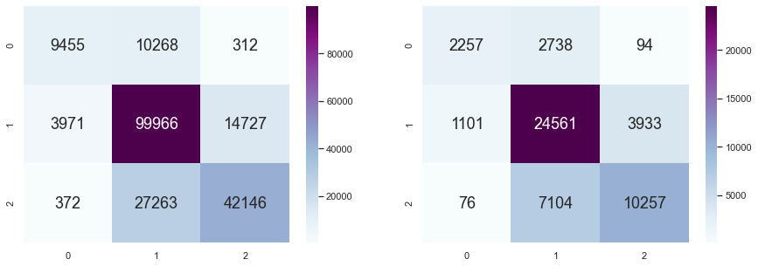
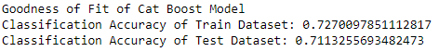
CATBOOST CLASSIFIER (CONT.)
Notes:
We did the same thing by used the same train and test dataset as before to fit it into the catboost classifier, and this is the accuracy that we got.
--------------------------------------------------------------------------------------------------------------------------------------
Parameters
Iterations: The number of trees to be built
Verbose: output info of training process every 10 iterations
Learning_rate = 1 : Used for reducing the gradient step. It affects the overall time of training: the smaller the value, the more iterations are required for training.

Slide 24
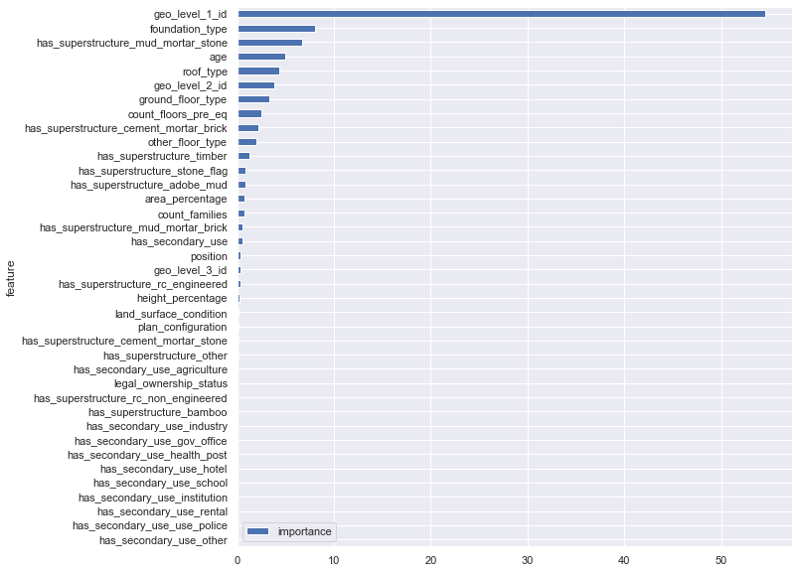
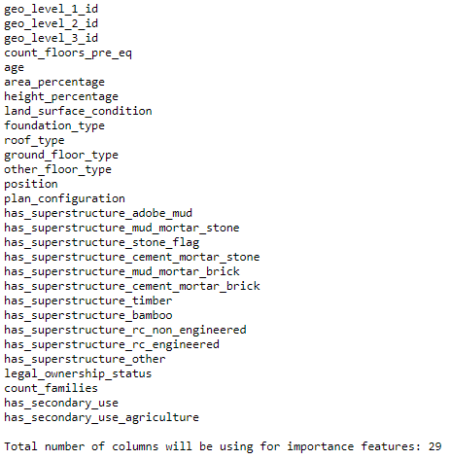
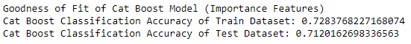
CATBOOST CLASSIFIER (IMPORTANCE FEATURES)
Importance features that have more than 0.01
Notes:
Next we picked out the more important features by using (catboost.feature_importances_) function with a gini index greater than 0.01, and we got this accuracy .

Slide 25
BENEFITS OF IMPORTANCE FEATURES
CATBOOST MODEL
 | Train Dataset of Classification Accuracy | Test Dataset of Classification Accuracy | Columns Used | Memory Usage (byte)
Catboost | 0.7270 | 0.7113 | 38 | 53,370,880
Catboost (Importance Features) | 0.7284 | 0.7120 | 32 | 43,363,840
Differences | 0.0014 | 0.0007 | 6 | 10,007,040
Notes:
As you can see the accuracy didn’t improve much but we are able to reduce the number of column thus decreasing memory usage. I will now pass my time back to eugene to conclude.

Slide 26

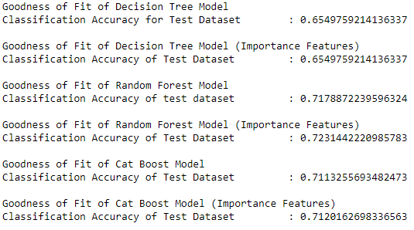
BEST ACCURACY OUT OF MODELS
 | Decision Tree | Decision Tree (Importance Features) | Random Forest | Random Forest (Importance Features) | Cat Boost | Cat Boost (Importance Features)
Test Dataset of Classification Accuracy | 0.6550 | 0.6550 | 0.7179 | 0.7231 | 0.7113 | 0.7120
Notes:
We can see an improvement in the accuracy of the prediction by making use of the importance features from the dataset. All in all, the random forest with the importance features has the highest accuracy among the other models and we will use this to predict the damage grade for the buildings.

Slide 27

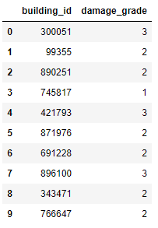
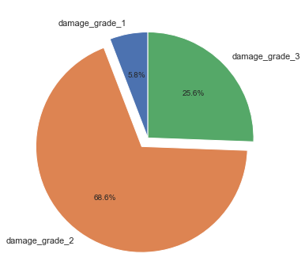
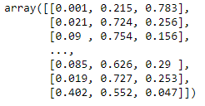
OUTCOME
Probability of damage grade for each building
Notes:
On the left side, we managed to generate the predicted damage grades for our test data based on the RandomForestClassifier with importance features which has the highest prediction accuracy.
By taking a look at the arrays in the middle figure, the numerical sum of each list inside actually sums up to 1, and each column represents the probability of damage grade for each building, so 3 different columns for 3 respective grades, starting from 1, 2, and 3.
Piechart is to show the spread of the predicted damage grade.
All in all, we have learnt that using features importance function plays an important role in selecting the best gini index predictors. This helps to increase performance and accuracy and optimize memory usage.

Slide 28


Contribution is the same
Notes:
In conclusion, all of us have contributed evenly to this project. Thank you!

